Slide 1
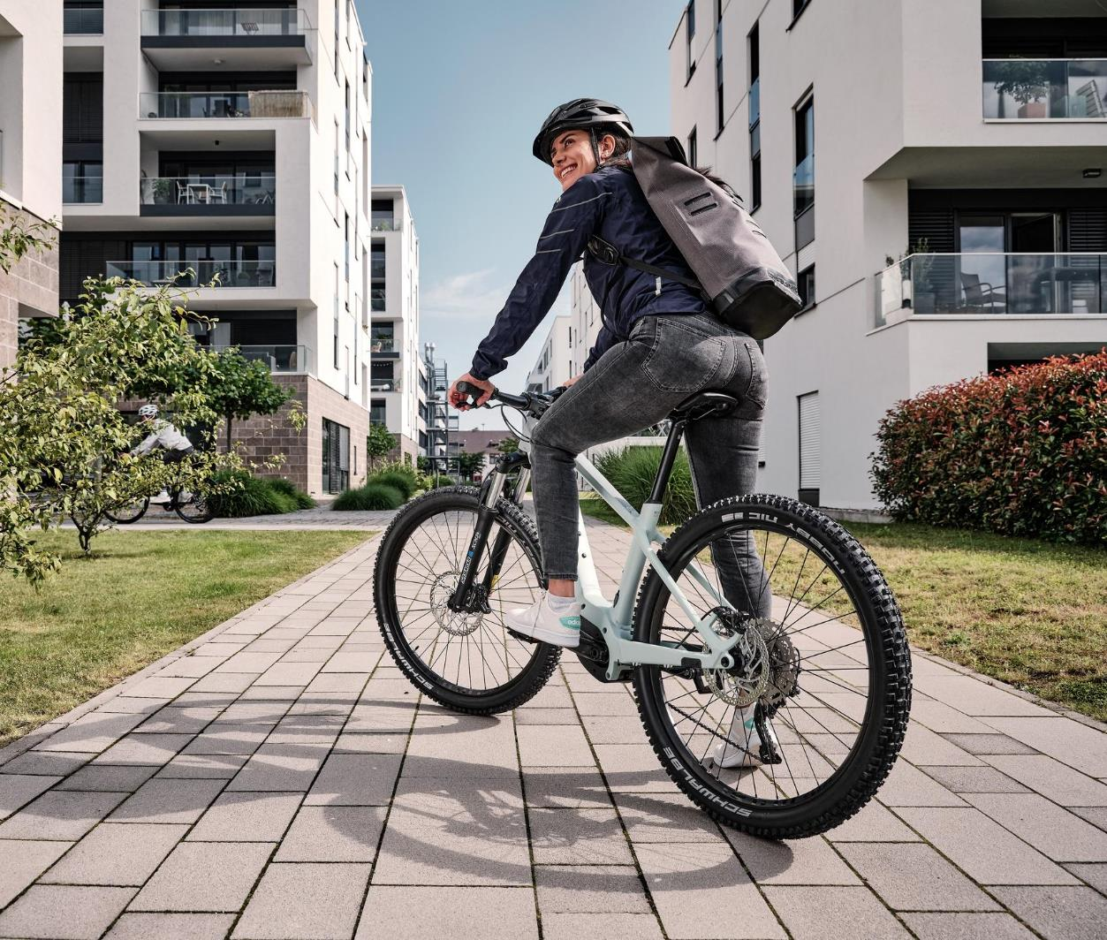


Find your dream bike with JobRad®
Your employer leases the bicycle of your choice.
You can ride it whenever you want – to work, in your spare time, on holiday or for sport.
[Kundenlogo]

Slide 2
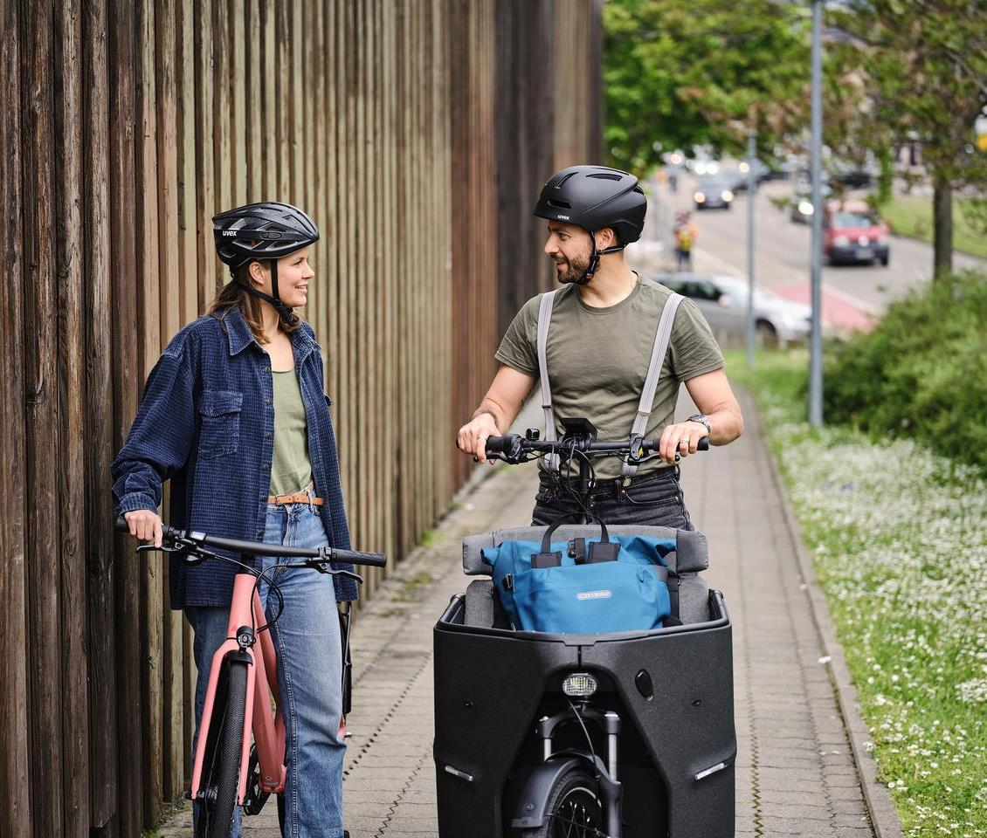
Choose the perfect bicycle for you – all types and brands

Slide 3
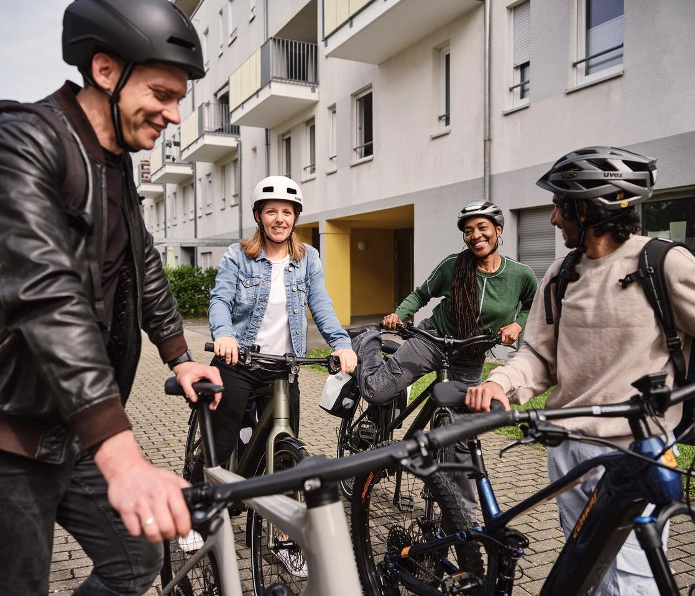
Save up to 40 % compared with direct purchase!

Slide 4
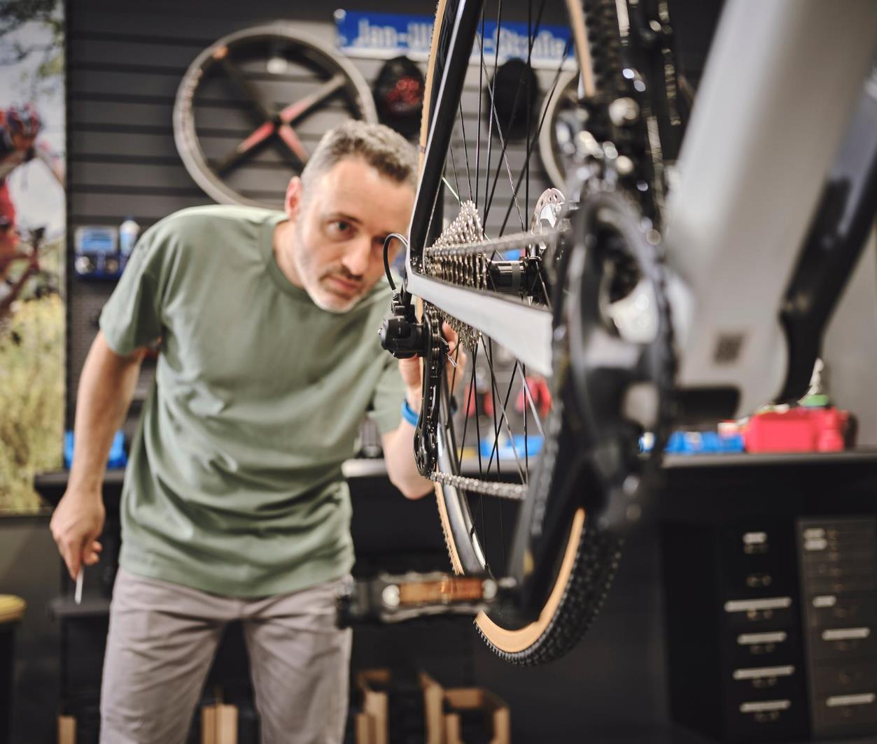
Perfectly equipped thanks to fully comprehensive insurance and repair services

Slide 5

Get up and go!
Apply for the bicycle of your choice via the meinJobRad®-Portal.
Feel free to contact:
[place e-mail address]
269-11.2024
[Kundenlogo]

